Slide 1



Time Series Econometrics Presentation
Homicides and Suicides by firearms in Cape
Town, 1986–1991
Renata Akhmadinurova, Charlotte Aspinall, Riccardo Conteduca, Paula Grcevic

Slide 2
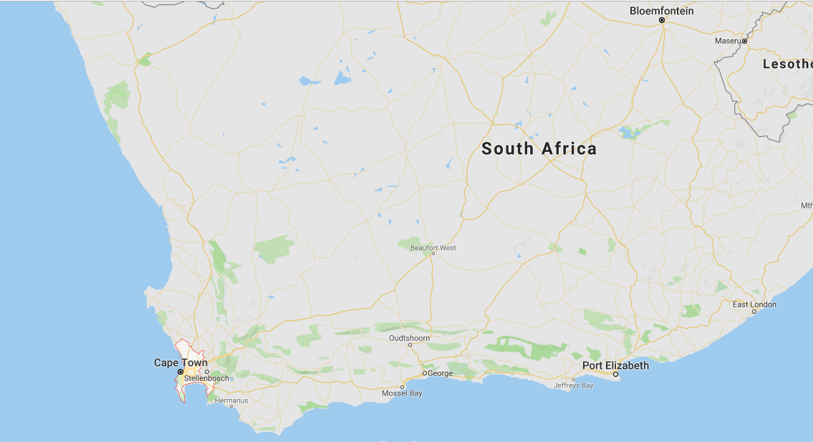
Background Information – Capetown in 1986-1991
Cape Town Population in 1990 – 2 ,296, 000
Late during the Apartheid Period (from 1948 to April 27, 1994) when internal resistance and activist groups were widespread but facing brutal and often violent crackdowns from the government.
In 1990, prominent resistance leaders such as Nelson Mandela were released from prison. Apartheid legislation which provided the legal basis for segregation was repealed on 17 June 1991
Notes:
Between 1987 and 1993, the National Party entered into bilateral negotiations with the African National Congress, the leading anti-apartheid political movement, for ending segregation and introducing majority rule.^{[22][23]} ,^{[3]} pending fully democratic, multiracial elections set for April 1994.^{[25]}

Slide 3
Description of the Data
The file contains, for each of the 313 weeks making up the years 1986 - 1991, the numbers of deaths recorded at the Salt River state mortuary, Cape Town, as falling in each of the following 5 categories:
firearm homicide,
nonfirearm homicide,
firearm suicide,
nonfirearm suicide,
legal intervention homicide.
Week | time | val.FH | val.NFH | val.FS | val.NFS | val.LIH
1 | 1986 | 0 | 27 | 0 | 4 | 0
2 | 1986.019 | 3 | 15 | 0 | 1 | 0
3 | 1986.038 | 1 | 15 | 1 | 2 | 3
4 | 1986.058 | 1 | 20 | 1 | 0 | 1
5 | 1986.077 | 3 | 13 | 3 | 1 | 1
6 | 1986.096 | 2 | 11 | 1 | 1 | 0
7 | 1986.115 | 0 | 10 | 1 | 2 | 1
8 | 1986.135 | 2 | 11 | 1 | 2 | 0
9 | 1986.154 | 3 | 16 | 2 | 1 | 8

Slide 4
Vector Auto Regression

Slide 5
Comparing Firearm Homicides to Legal Intervention Homicides
Hypothesis: If there is an increase in Firearm Homicides (FH) there will be an increase in Legal Intervention Homicides (LIH).
Method:
Check if the data is stationary
Assess the appropriate number of lags to use in VAR model
Model the data
Assess accuracy
Assess coefficients
Measure impulse response

Slide 6
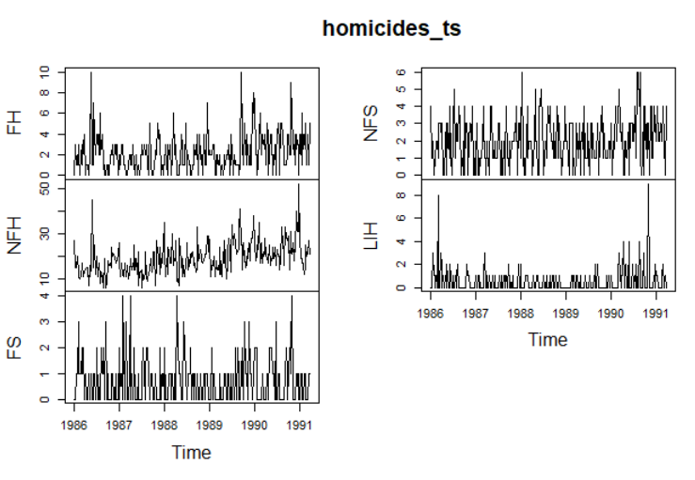
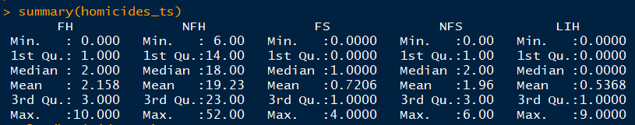
Check if data is stationary
From initial visual exploration we see that the data does not have a trend, and that there is a none-zero mean.
Therefore when we compute the Augmented Dickey-Fuller (ADF) Test we use “type = ‘none’”
The results of the ADF gives us p-values of less than 0.05 for both FH and LIH time series, therefore we can accept that these are both stationary time-series models. As a result, we can continue in our analysis and do not have to consider using a cointegrated model.

Slide 7
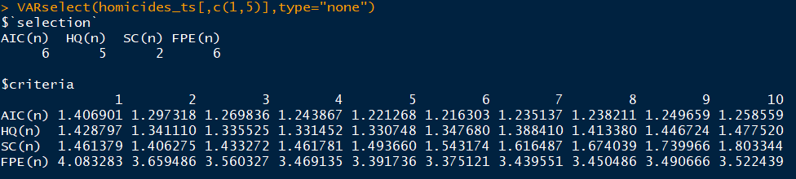
Assess the appropriate number of lags to use in VAR model
Using VARselect, the model with a lag-order of 6 resulted in the model with the lowest AIC, and therefore the most accurate.
We chose to use the AIC indicator of model accuracy due to the relatively small number of data points we are using.
Therefore we now continue to build our VAR model using a lag-order of 6, and a type of “none”.

Slide 8
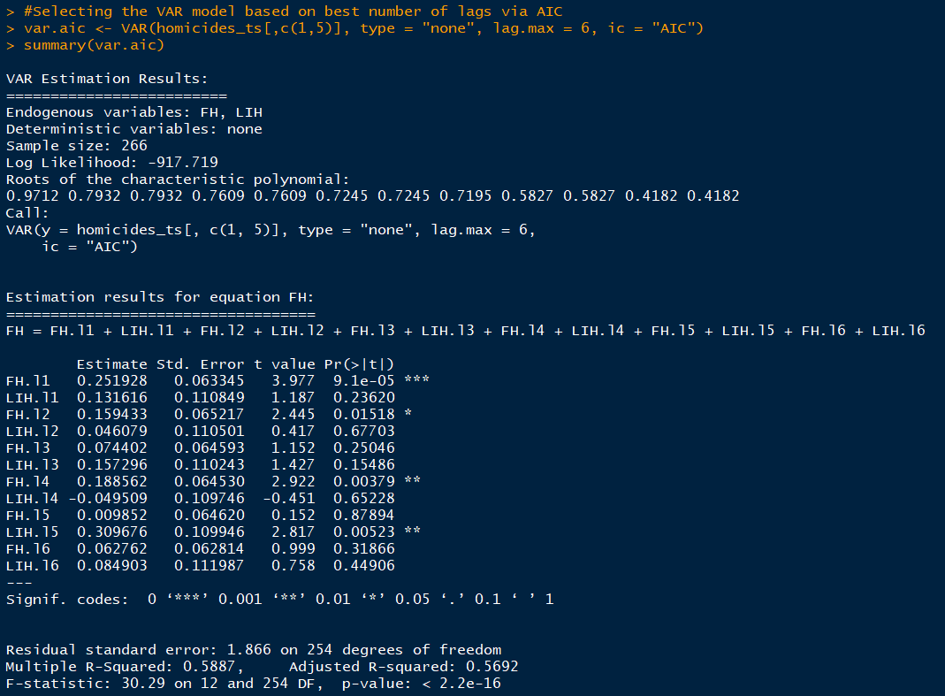
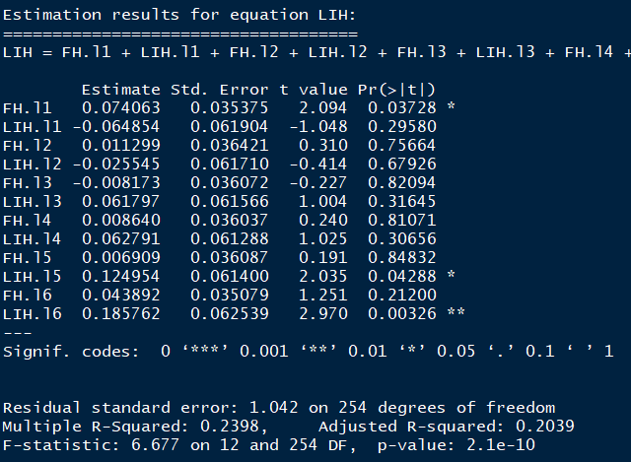
Model the Data - Assess the accuracy

Slide 9

Model the Data - Assess the coefficients
From the VAR model, we see that we have an adjusted R-squared of 0.5692 for FH, and 0.2039 for LIH. This shows that the model is more accurate for FH than LIH.
However we can see from the coefficients that FH are more influenced by previous FH activity than by LIH. This would suggest that a simpler AR(p) model would be sufficient model for FH data.
The coefficients for the LIH model shows very weak influence for all endogenous variables on the response variable. This is consist with the result we have seen for the R-squared value.

Slide 10
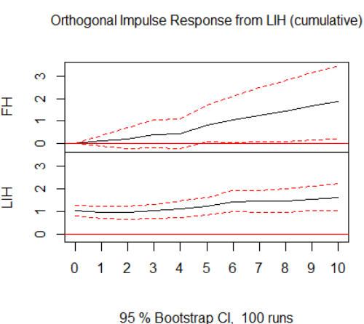
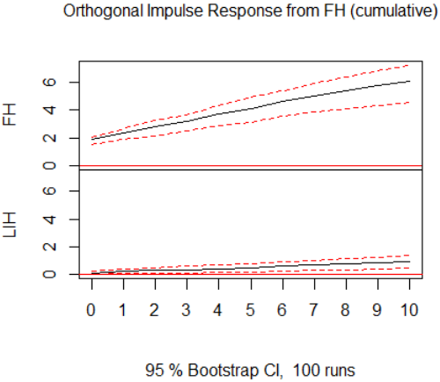
Measure Impulse Response

Slide 11
Model 2- Finite Mixture Model

Slide 12
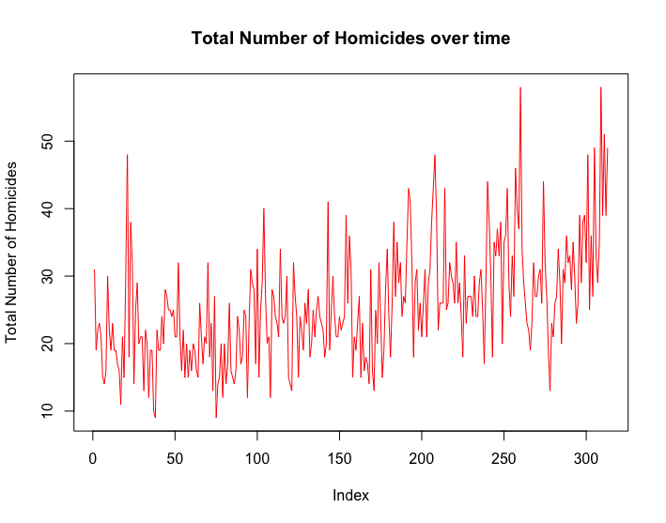
What does the total number of crimes over time look like?
all_homicides <- as.numeric(apply(data[,1:5],1,sum))
plot(all_homicides,
type = 'l', ylab = 'Total Number of Homicides',
main = 'Total Number of Homicides over time',
col = ‘Red’)
Can we observe how the crimes are distributed over time?

Slide 13
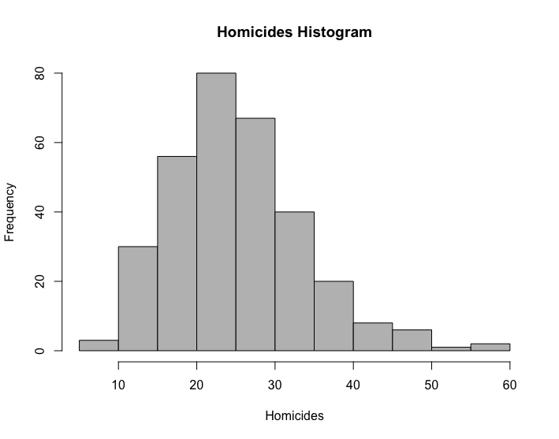
Histogram of the homicides dataset
Even before looking at the histogram, we might already have an idea on what model to use for our mixture, but it might be useful to visualize it before arriving to conclusions.

Slide 14
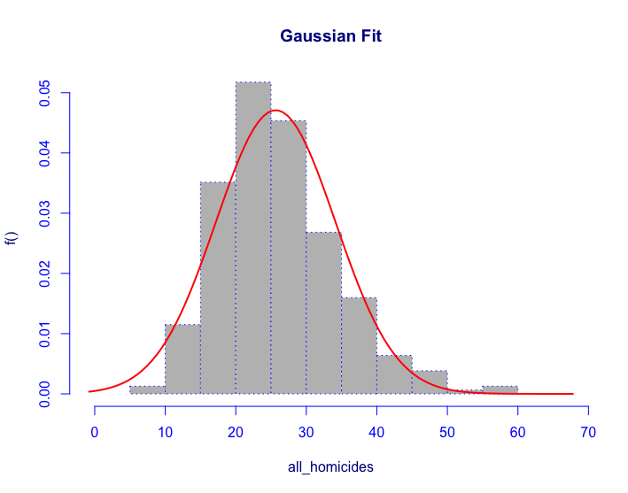
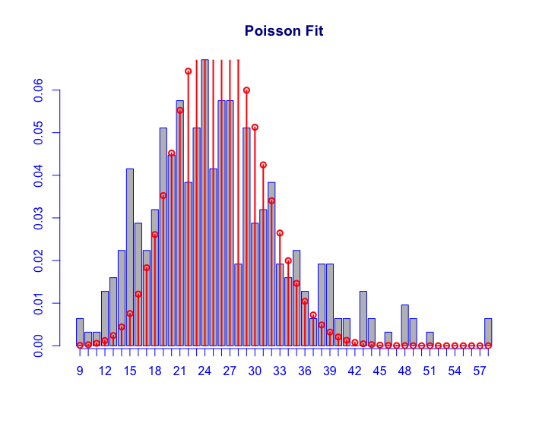
Gaussian vs Poisson
histDist(all_homicides, family = c('NO'), main = 'Gaussian Fit')
histDist(all_homicides, family = c('PO'), main = 'Poisson Fit')

Slide 15
Why Poisson
It makes sense to use Poisson when we have countable number of events occurring in an interval of time.
In this case, we have five different types of homicides over a period of 313 weeks.
We will then proceed by using a multi Poisson distribution for our mixture model and pick the best model according to the BIC

Slide 16
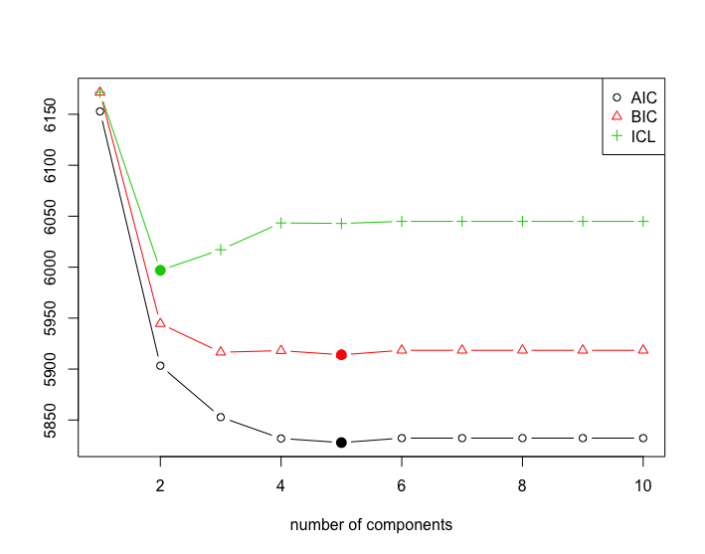
Poisson Mixture
To consider a range of clusters we are going to use stepFlexmix, from the flexmix library.
Where k is the range of values
Nrep is the number of iterations the EM algorithm runs for each k value
The model is the Poisson, FLXMmvpois()
poisson_mix <- stepFlexmix(crime_matrix ~ 1,
k = 1:10, nrep = 5,
model = FLXMCmvpois(),
control = list(tolerance = 1e-15, iter = 1000))

Slide 17
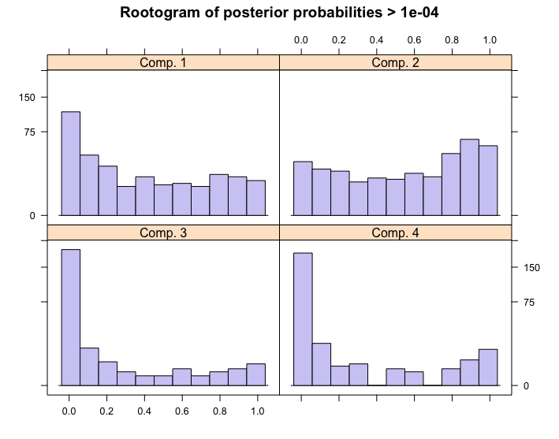
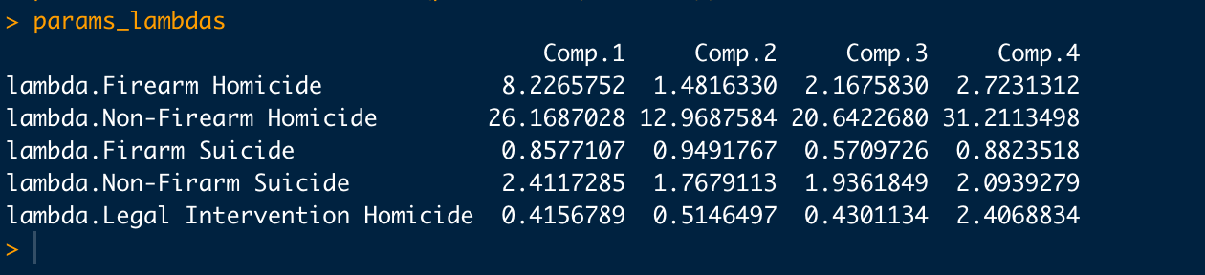
Finding the best model
We can find the best model by using the function getModel.
best_fit <- getModel(poisson_mix, which = ‘BIC’)
This will give us our subpopulation based on the minimization of the BIC, although we can use the same function for the AIC or ICL
In our case, the best fit model has 4 different clusters, we can get the lambda parameters, which can be thought of as the average number of events in an interval of time by using the parameters() function :
params_lambdas <- data.frame(parameters(best_fit))

Slide 18
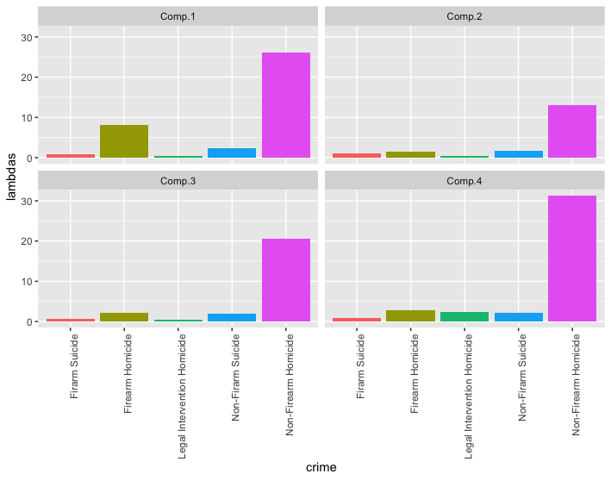
Plotting the Sub Populations
params_lambdas_crime <- params_lambdas %>%
mutate(crime = colnames(crime_matrix))
params_lambdas_crime %>%
gather(cluster, lambdas, -crime) %>%
ggplot(aes(x = crime, y = lambdas, fill = crime)) +
geom_bar(stat = "identity") +
facet_wrap(~ cluster) +
theme(axis.text.x = element_text(angle = 90, hjust = 1), legend.position = "none")
Four meaningful subpopulations were found; through the use of clustering with PMM ,we can find the most critical periods of time.

Slide 19
HMM, HSMM, GARCH

Slide 20
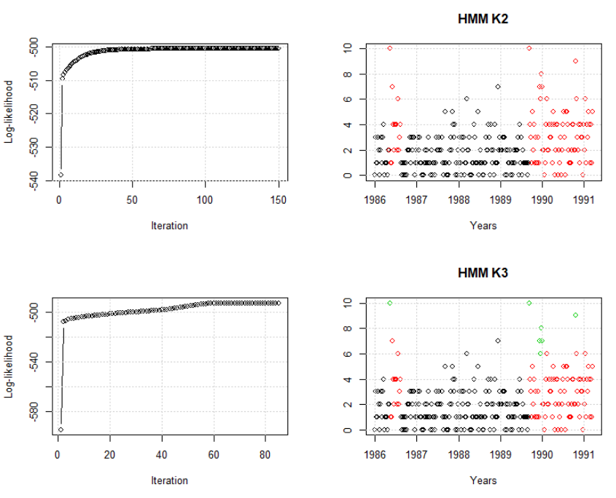
Hidden Markov Model - HMM
We build a model only for Firearm Homicides
With Poisson – because we have a discrete variable, initial parameters for lambda – 2,4,6
3 states model seems to capture some outliers in a different cluster (green)
According to AIC and BIC, 3 states model is better

Slide 21

Hidden Semi Markov Model - HSMM
We built a K-means clustering model and then calculated average ‘time’ to stay in class
These estimations were used for initializing values for Poisson sojourn

Slide 22
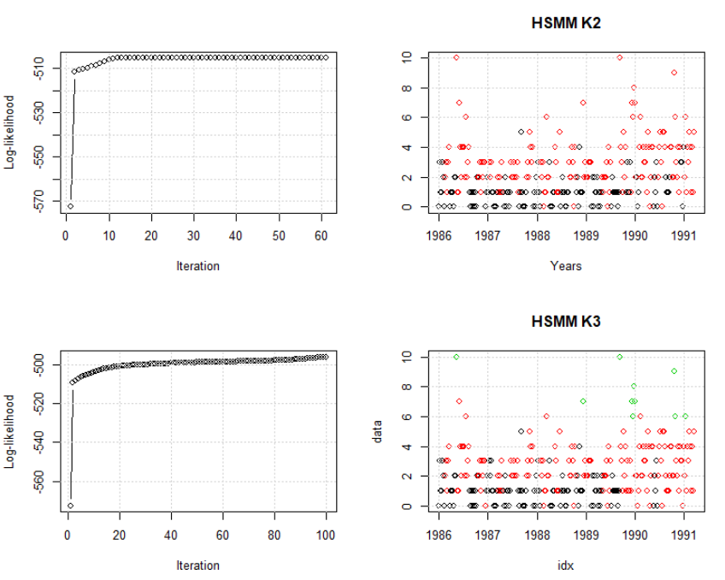
Hidden Semi Markov Model - HSMM
Hidden Semi Markov models tend to predict states horizontally
3 states model seems to capture some outliers in a different cluster (green)
According to AIC and BIC, 3 states model is better

Slide 23
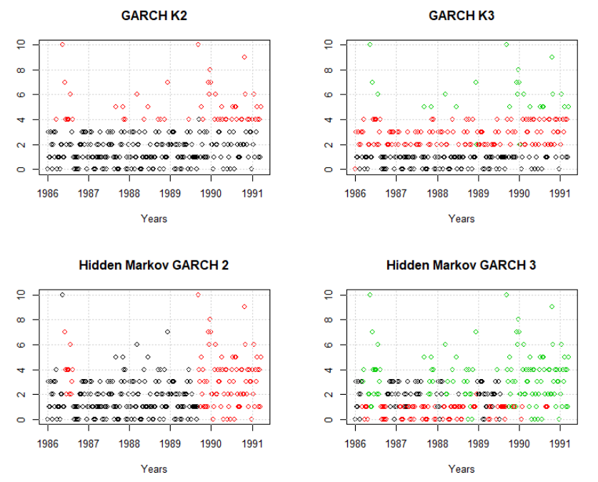
Mixtures of GARCH
Different variations of GARCH do not improve the model compared to sGARCH (sARCH, eGARCH, girGARCH, tGARCH)
The best model specification – sGARCH, sstd
2 cluster model predict volatility better than 3-cluster
Hidden Markov GARCH and simple GARCH give similar performance

Slide 24
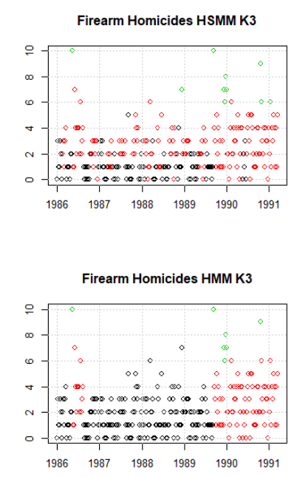
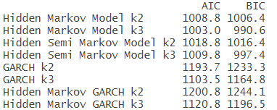
Results
According to information criteria, the best models are Hidden Markov and Hidden Semi Markov
Assuming 3 states give better results

Slide 25
Appendix

Slide 26
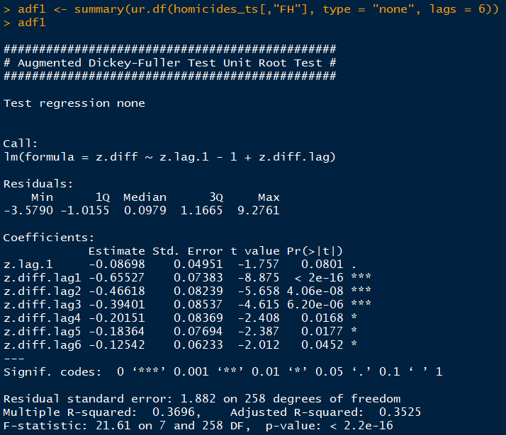
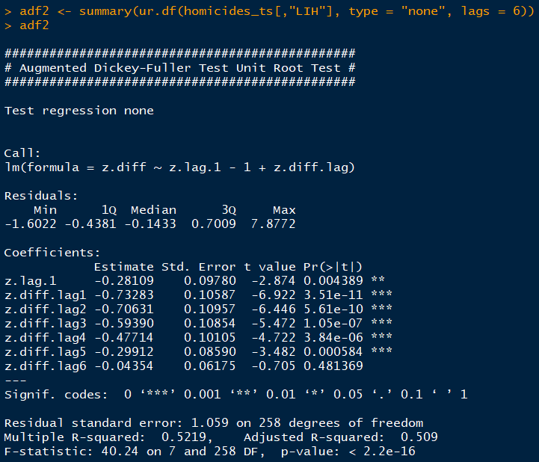
Augmented Dickey-Fuller Test Results (Firearm Homicides / Legal Intervention Homicides)

Slide 27
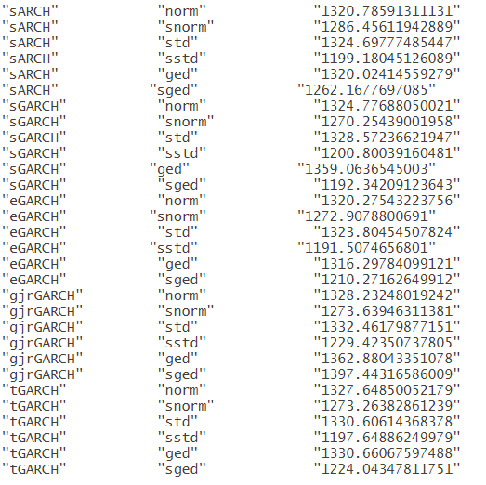
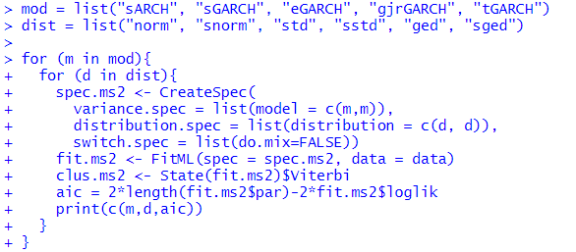
Appendix: GARCH variations

